Slide 1
Climate and Development
Climate and growth
Climate v weather
Climate and development

Slide 2
Lectures
Science
Scenarios & emission reduction options
Costs of emission reduction
Instruments for emission reduction
Impacts of climate change & adaptation
Economic impacts of climate change
Climate and development
Optimal emission reduction
Discounting, uncertainty, equity
International environmental agreements

Slide 3
Climate and Development
Climate and growth
Climate v weather
Climate and development

Slide 5
Climate change and growth
Climate change can affect welfare through four channels
Utility (e.g., species loss)
Labour (e.g., morbidity)
Output per worker (e.g., agricultural productivity)
Depreciation (e.g., floods)
Utility: no impact
If output is lower in period t, less is consumed and less is saved, so that there is less capital and less output in period t+1
Ditto for higher depreciation

Slide 6
Climate change and growth -2
In principle, people could compensate through increased savings
Not rational as the returns to capital have fallen
Besides, this would cut consumption even more
If the labour force shrinks, there is more capital per worker, higher labour productivity, higher wages
The rational response is to consume the windfall, save less, until the capital-labour ratio is back at its desired value
Effect is small as the health impacts of climate change primarily fall on the non-working population

Slide 7
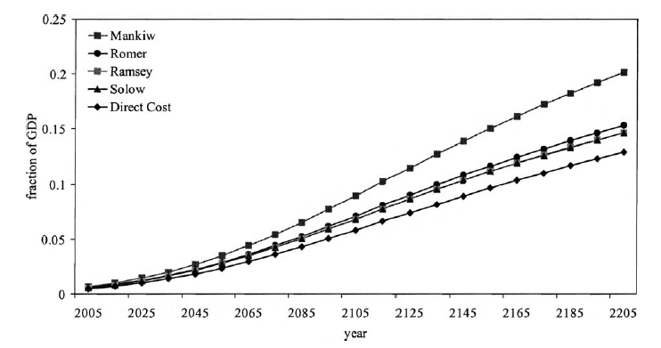

Slide 8
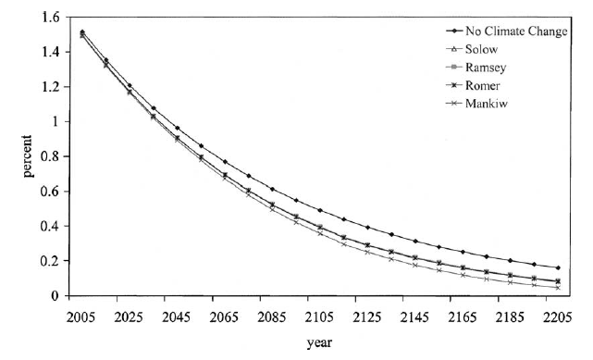

Slide 9
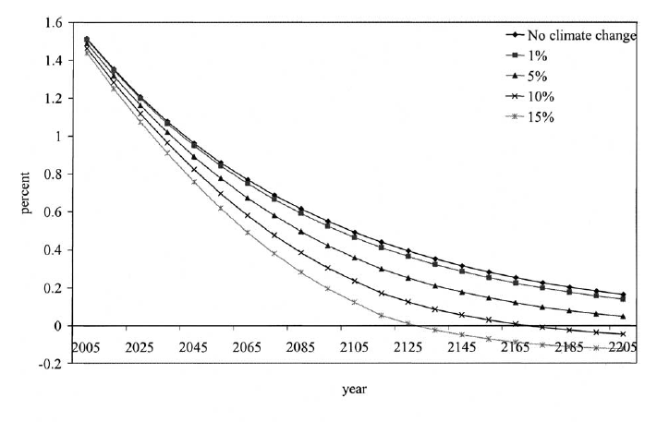

Slide 10
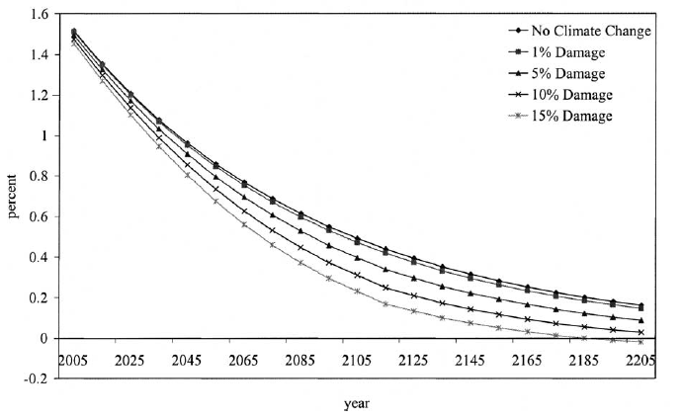

Slide 11
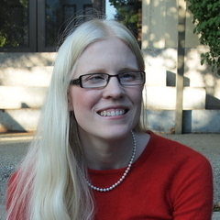
Dell, Jones, Olken, 2012, AEJ Macro

Slide 12
Climate and Development
Climate and growth
Climate v weather
Climate and development

Slide 13
Weather v climate
Estimating the impact of climate change is difficult because it changes slowly over time while other important things change faster
Climate differences over space are larger but confounded with all sorts of everything
Estimating the impact of weather is easy because data is plentiful and shocks are random (or rather orthogonal to the economy)
Extrapolating from weather shocks to climate change is problematic

Slide 14
Weather v climate
Extrapolate from weather shocks to climate change?
Climate is what you expect, weather is what you get
Weather throws the punches, climate trains the boxer
Weather is your mood, climate is your personality
If you don't like the weather, wait. If you don't like the climate, move.
Adaptation is different
Put up your umbrella, buy an umbrella
Close the flood gates, build flood gates
Short-term vs long-term elasticity
Fixed vs malleable capital stock, technology
Expectations matter too

Slide 15
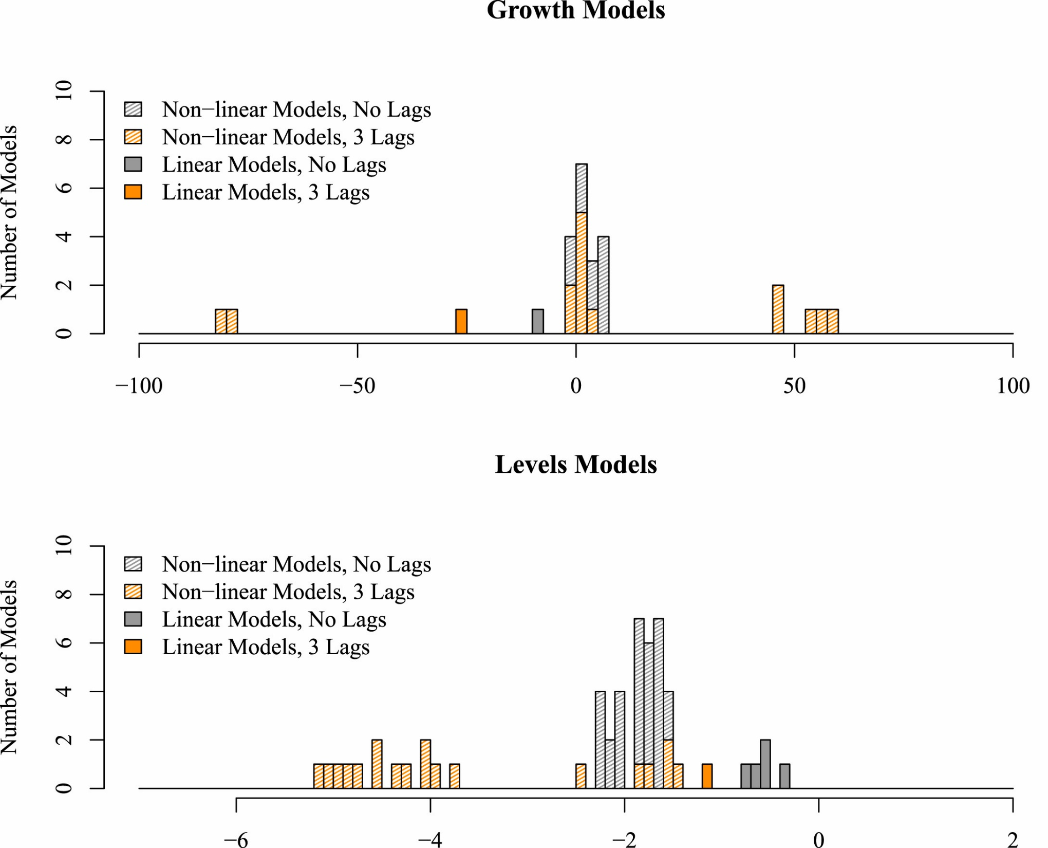


$$∆\ln{y_{t}}=f\left(T_{t}\right)$$
$$∆\ln{y_{t}}=f\left(∆T_{t}\right)$$

Slide 16
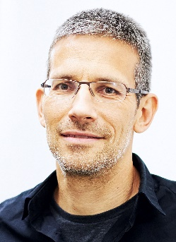
Barrios, Bertinelli, Strobl, 2010, REStat

Slide 17
Barrios, Bertinelli, Strobl, 2010, REStat

Slide 18
Climate and Development
Climate and growth
Climate v weather
Climate and development

Slide 19
Climate and poverty
Cool countries tend to be rich, hot countries tend to be poor

Slide 20
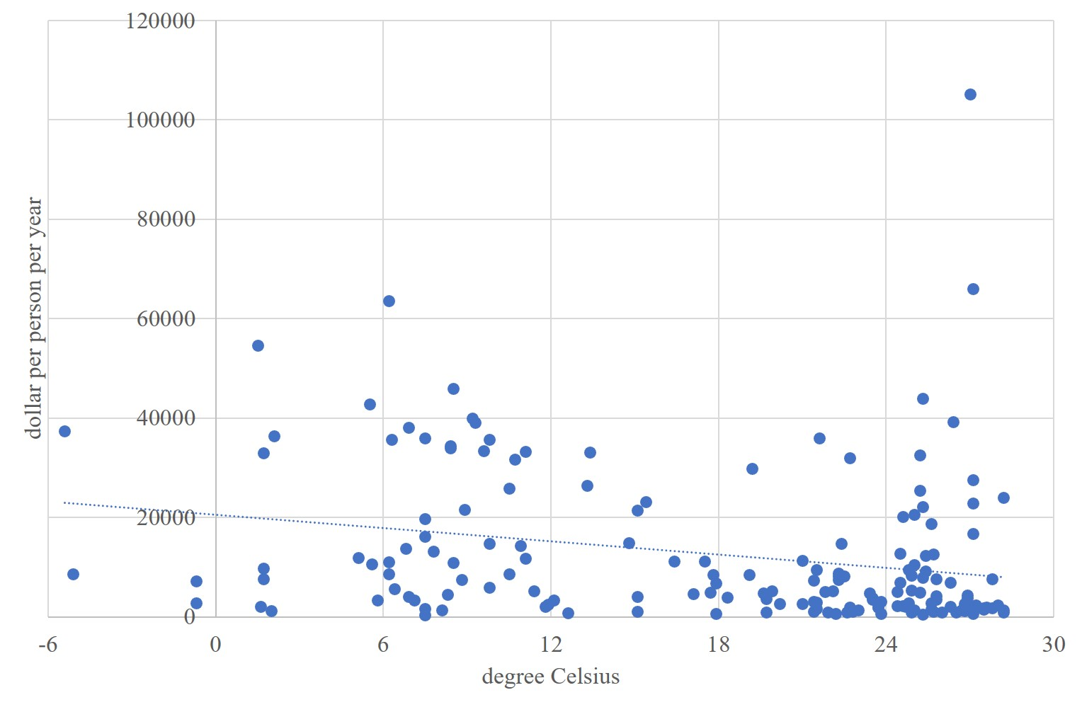
Cool countries tend to be rich, hot countries poor - 2000

Slide 21
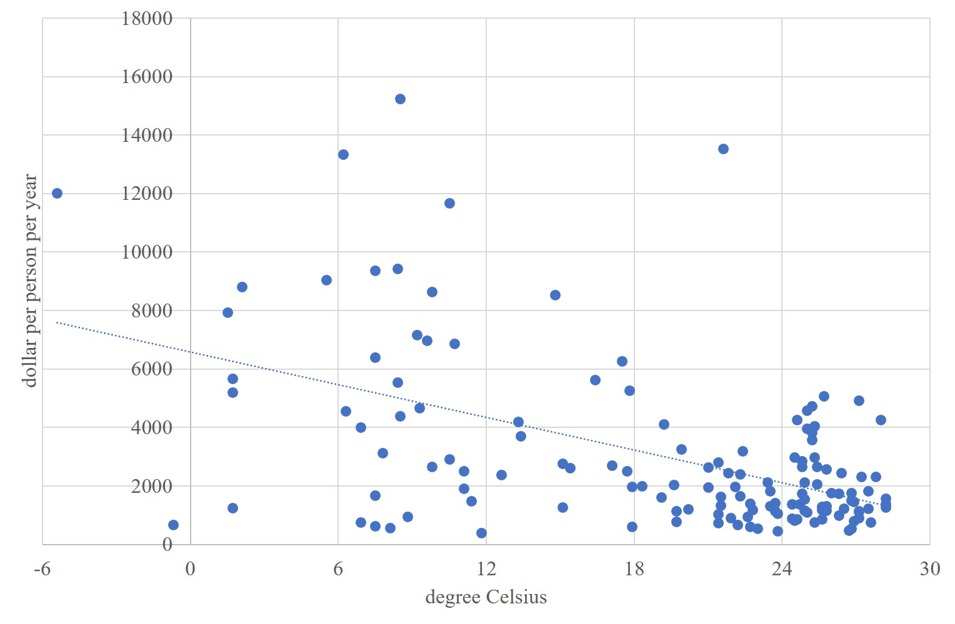
Cool countries tend to be rich, hot countries poor - 1950

Slide 22
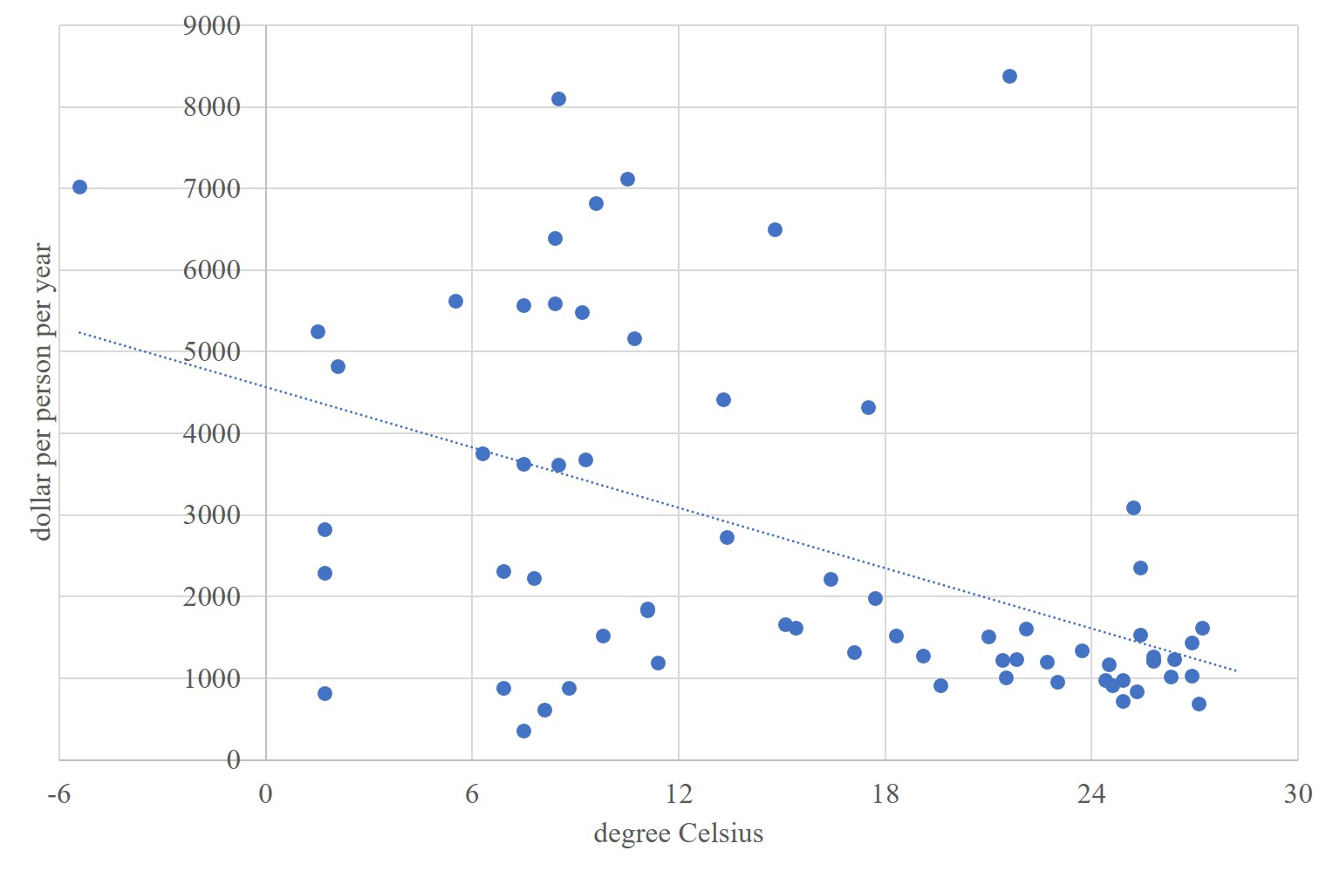
Cool countries tend to be rich, hot countries poor - 1913

Slide 23
Cool countries tend to be rich, hot countries poor - 1900

Slide 24
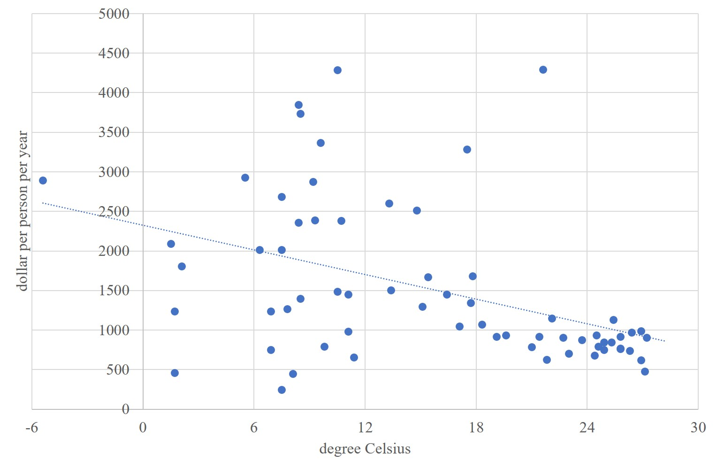
Cool countries tend to be rich, hot countries poor - 1870

Slide 25
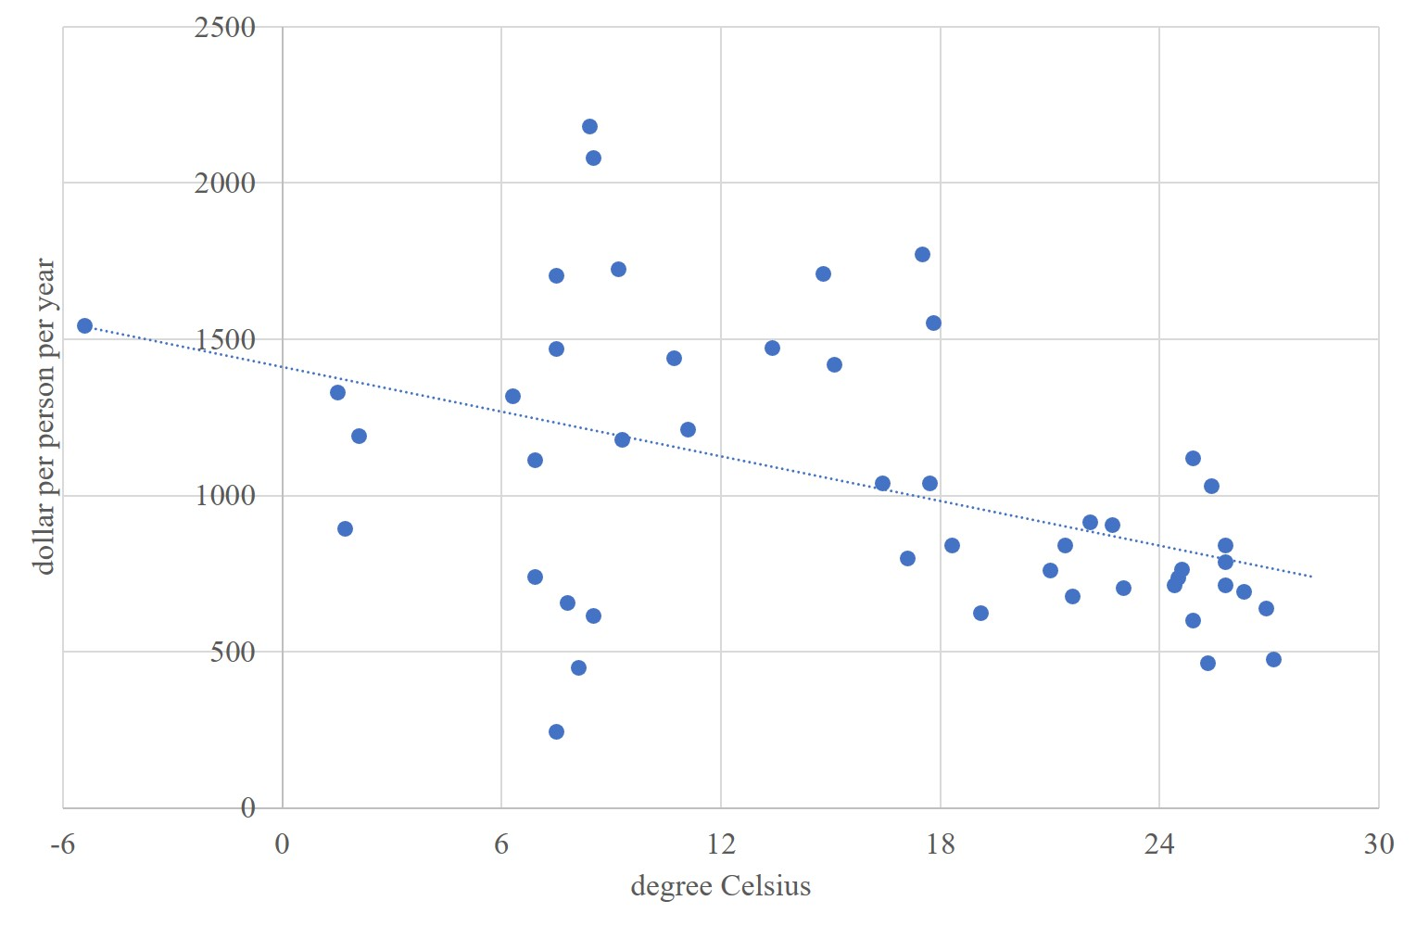
Cool countries tend to be rich, hot countries poor - 1820

Slide 26
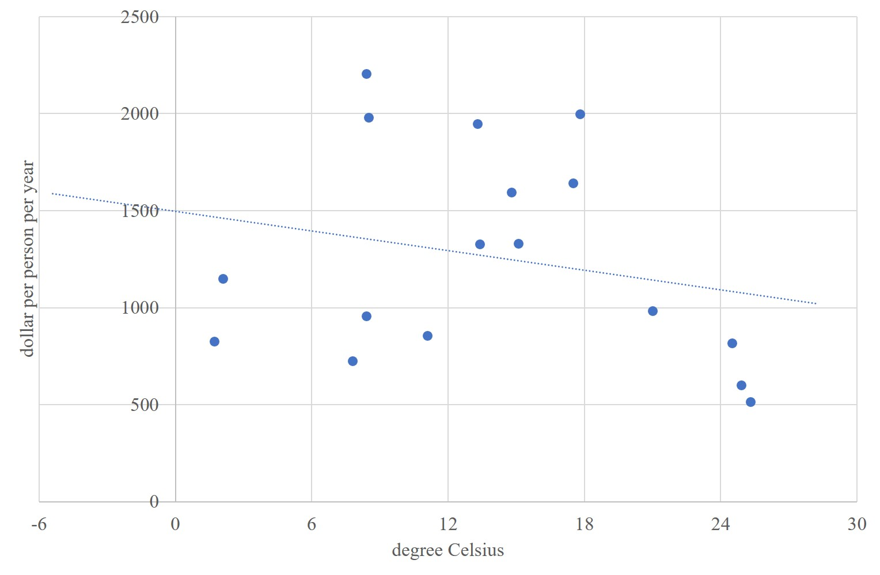
Cool countries tend to be rich, hot countries poor - 1800

Slide 27
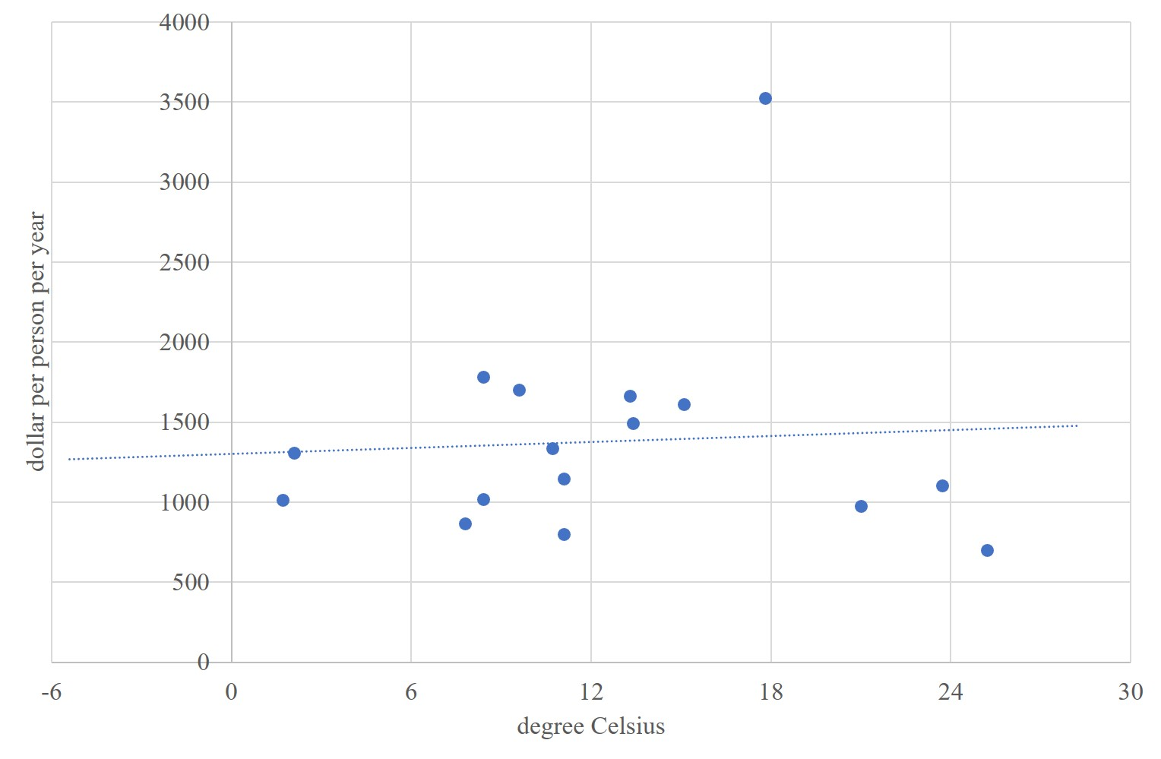
Cool countries tend to be poor, hot countries rich - 1750

Slide 28
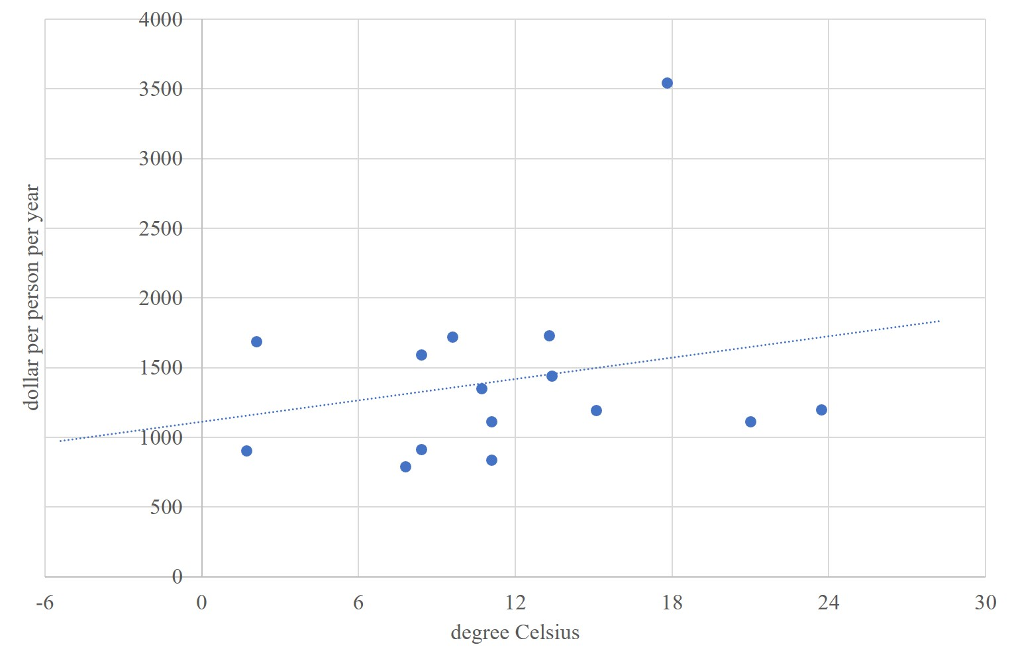
Cool countries tend to be poor, hot countries rich - 1700

Slide 29
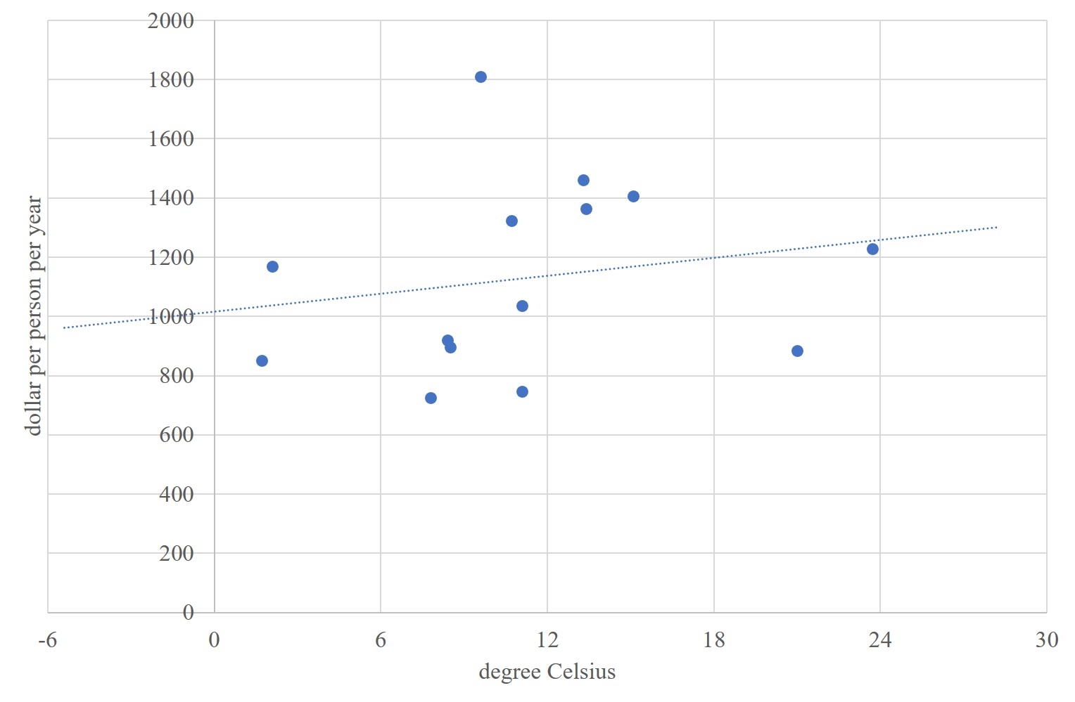
Cool countries tend to be poor, hot countries rich - 1650

Slide 30
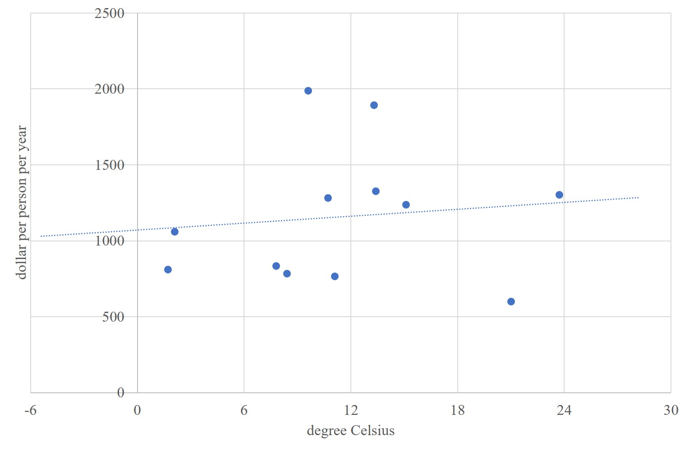
Cool countries tend to be poor, hot countries rich - 1600

Slide 31
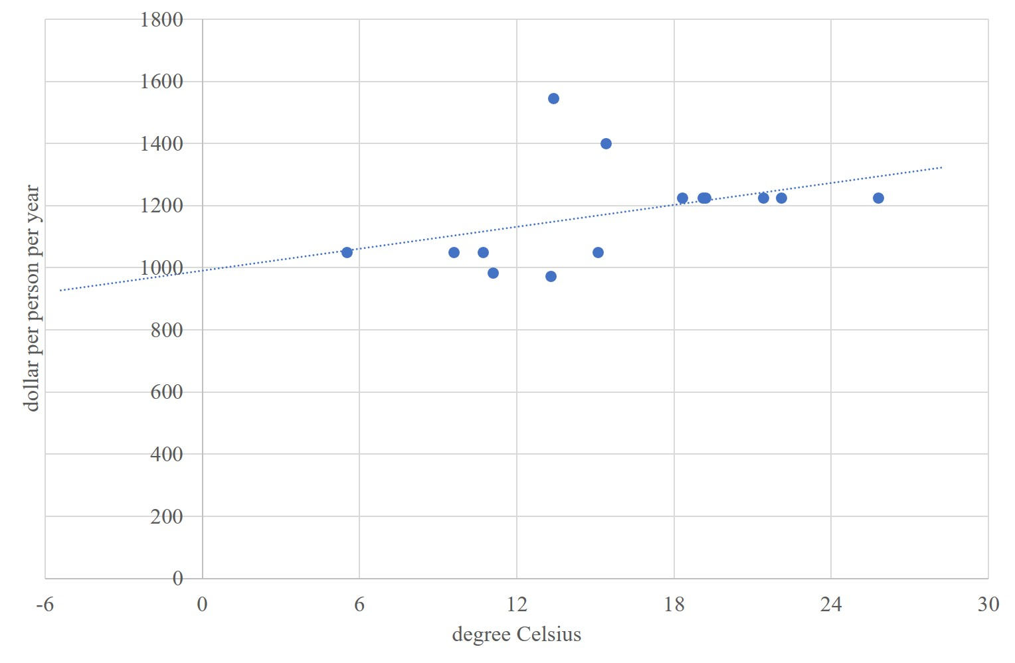
Cool countries tend to be poor, hot countries rich - 0

Slide 32
Climate and poverty
Cool countries tend to be rich, hot countries tend to be poor
Correlation sure, in recent centuries, but causation?

Slide 33
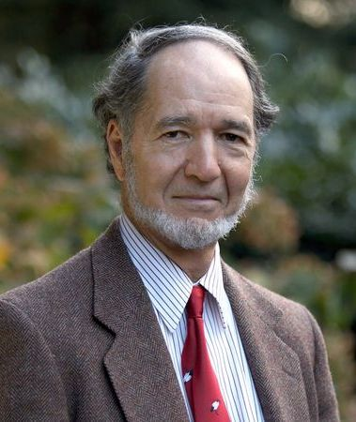
Climate and poverty
Cool countries tend to be rich, hot countries tend to be poor
Correlation sure, in recent centuries, but causation?
Diamond: Climate and geography are destiny

Slide 34
Olsson, Hibbs, 2005, EER

Slide 35
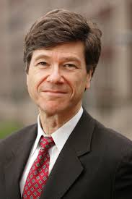
Climate and poverty
Cool countries tend to be rich, hot countries tend to be poor
Correlation sure, in recent centuries, but causation?
Diamond: Climate and geography are destiny
Sachs: Climate and geography are important

Slide 36
Gallup, Sachs, Mellinger, 1999, IRSR

Slide 37
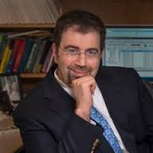
Climate and poverty
Cool countries tend to be rich, hot countries tend to be poor
Correlation sure, in recent centuries, but causation?
Diamond: Climate and geography are destiny
Sachs: Climate and geography are important
Acemoglu: Climate and geography were important

Slide 38
Acemoglu, Johnson, Robinson, 2001, AER

Slide 39
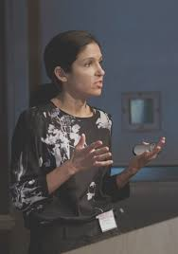
Climate and poverty
Cool countries tend to be rich, hot countries tend to be poor
Correlation sure, in recent centuries, but causation?
Diamond: Climate and geography are destiny
Sachs: Climate and geography are important
Acemoglu, Easterly, Rodrik: Climate and geography helped to shape institutions, but nowadays institutions rule
Dalgaard: Adding subnational observation, climate is important
Johansson: It’s UV, actually, via blindness
Alsan: Tse-tse did it (in the past)

Slide 40
Poverty traps?
If infant mortality is high (and it is in hot and wet climes), parents would have many children to ensure that at least a few survive. Risk-average parents would have more children than they want. Parents could not afford health care and education. Children grow up to be poor too.
If there is a risk of losing it all (and there is in volatile climes), there is no point in saving for the future. A feast and famine culture gets engrained. May also steer investment in non-perishables, such as education.

Slide 41
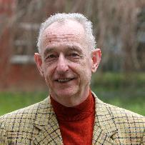

Climate and culture
Depression, aggression, xenophobia, autocracy, and individualism all associate with climate variables
Higher crop yields cause long-term orientation
More volatile climate causes loss aversion
A lower discount rate and risk aversion imply higher investment
Increase in seasonality necessitated food storage which enabled agriculture

Slide 42
Climate change and poverty
Climate change could intensify such mechanisms.
This would be an enormous welfare loss.
However, this is still speculative – and it clear that there is no ground for fatalism
Cultures change
Infectious disease is treatable and preventable

